Slide 1
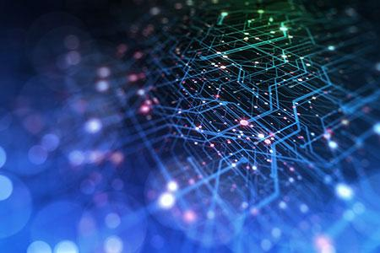
Data Session 1&2 Report
About 16 participants
Notes:
Thanks for the introduction
Thanks to the organizers for the invitation to give a keynote
Of course, I would like also to thank all the collaborators and students, postdocs and researchers who collaborated with me.
Don’t count, there are more than 450 ;-)
You know it already; it is extremely hard to succeed alone in research. So, I took the easy way: I collaborated with many talented researchers.
I would like to thank all of them for sharing some of their time and for all the discussions we had.

Slide 2
Data Day 1: Highlights
Presentations:
Robert – State of Data at ANL
Brad – Negotiations for Datasets and Legal
Jorge shared experiences from BSC and Europe
Carlo – AdaParse: Accuracy Aware Parsing
Discussions:
Tom – Narratives for Unstructured Grids and Particles using Feature Detection
Tanjin – Scraping Closed Scientific Texts from Academic Publishers
Matthew, Arham – Synthetic Parallel Code and Deduplication for Code
Junchao – PETSc Support Email Lists as a Source of Technical Information

Slide 3
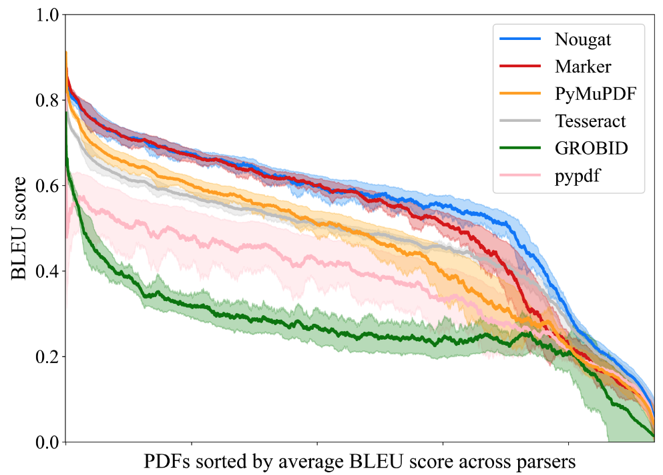
Highlight: AdaParse Accuracy across Parsers
setting 25k PDFs (ArXiv, MedRXiv, MDPI, BioRXiv, Nature, BMC); digital-born
parser performance varies but is correlated (for most PDFs)
performance comes at different cost:
Extraction = fast
OCR/ViTs = slow
PyMuPDF: 50x faster than Nougat

